Slide 1

Ben Swenson - John Anthony Person - Andy McDowell

Slide 2
Purpose
Community
User
Post
Post
Posts
Post
Post
Post

Slide 4
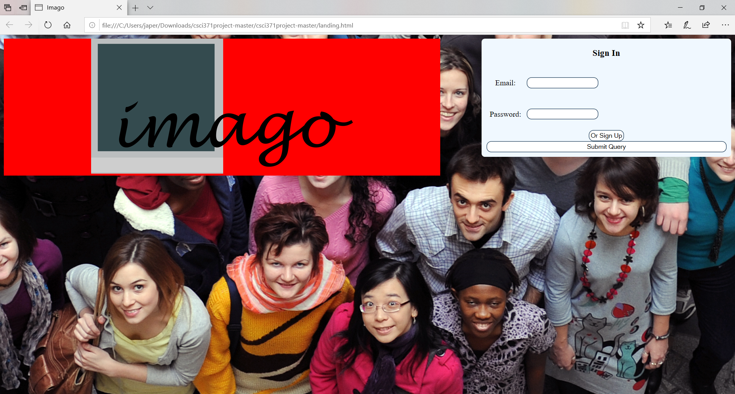

Slide 6
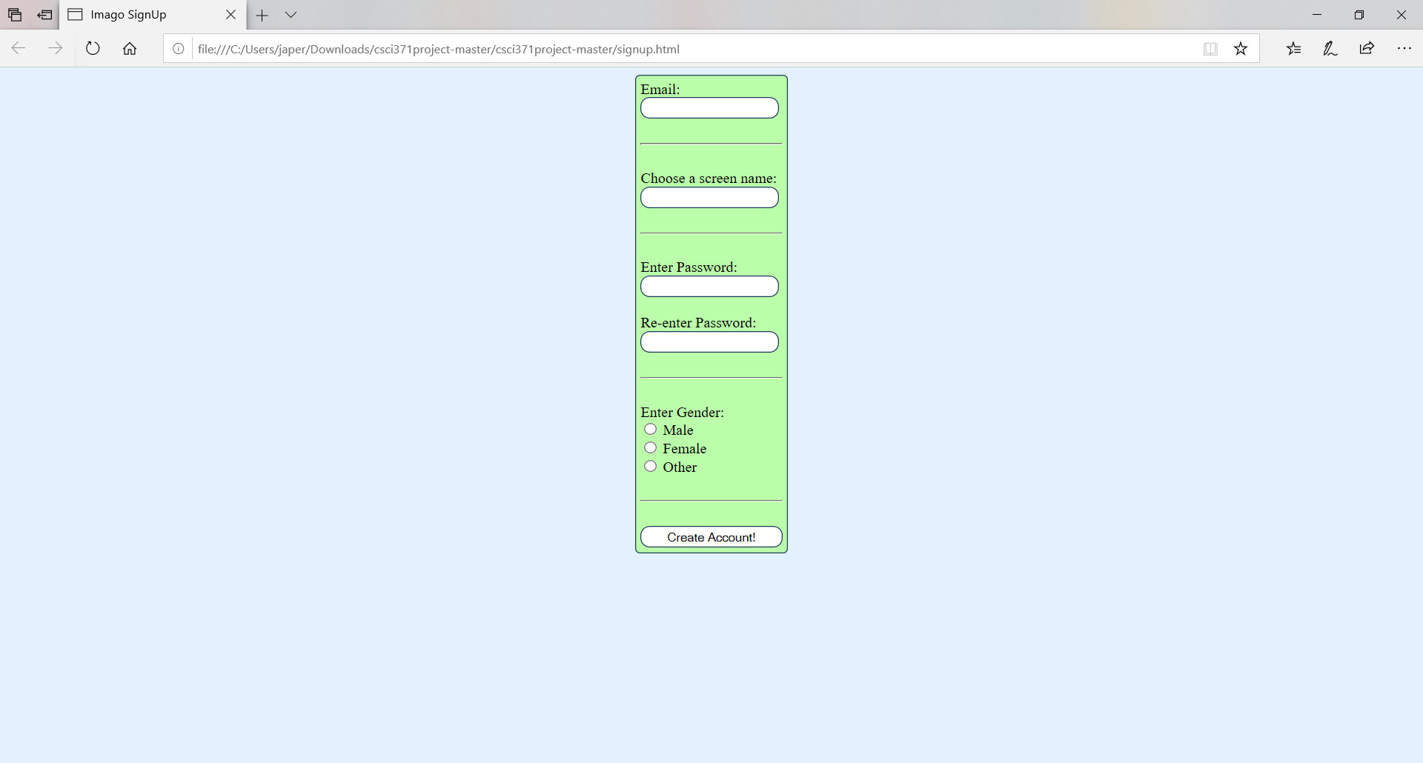

Slide 9
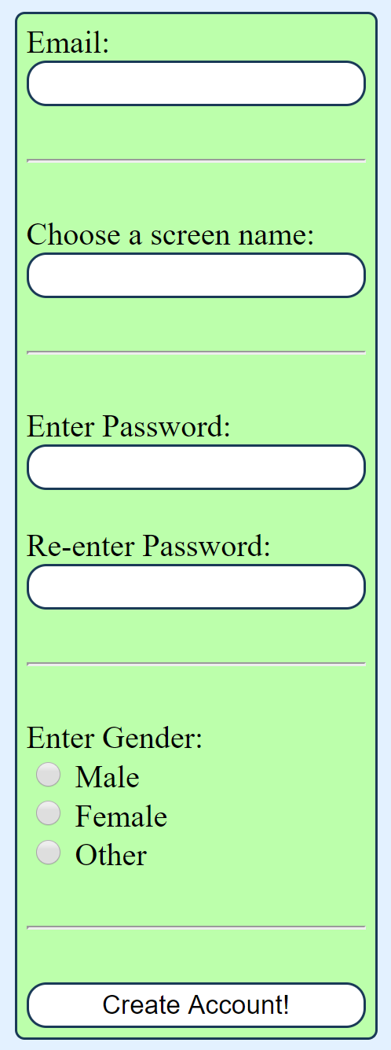
Formatted like an email.
Isn’t saved. Display name can be anything.
Passwords aren’t check to be the same.
Checks if it has been clicked.
Sent to nowhere and returns to the landing page

Slide 10

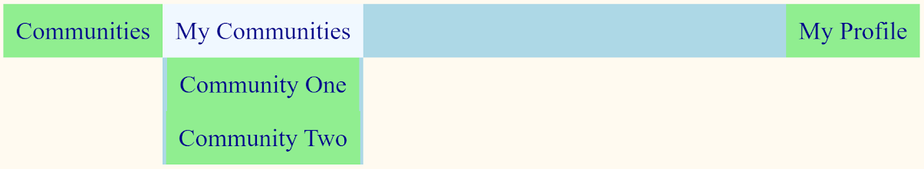
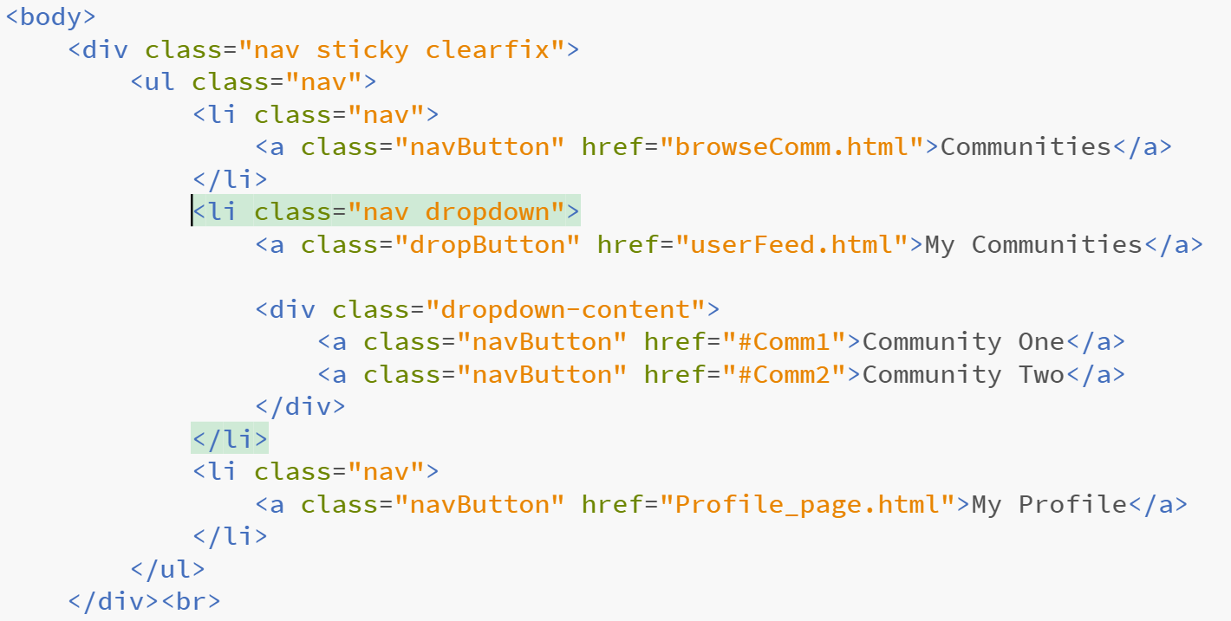

Slide 11
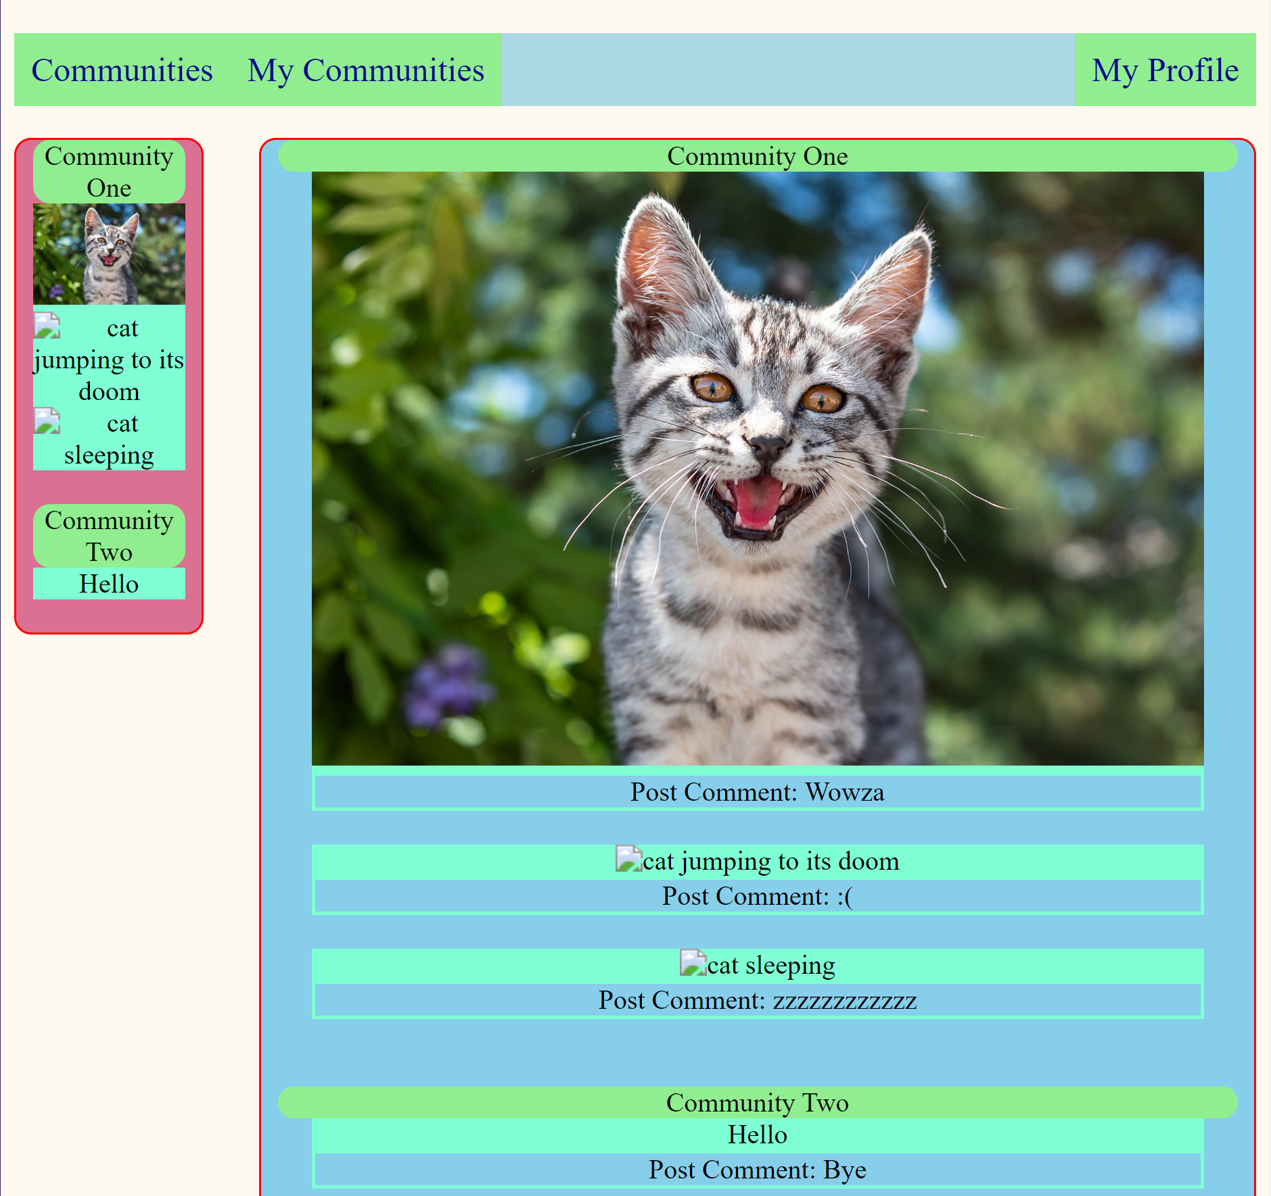

Slide 12
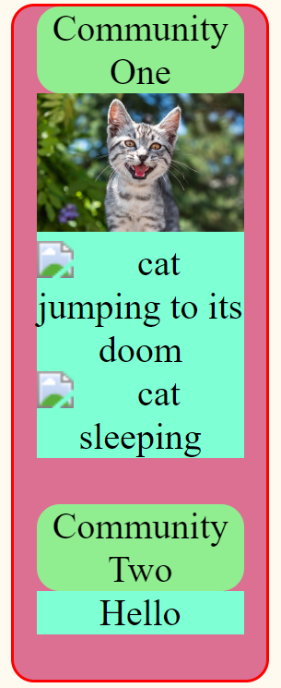
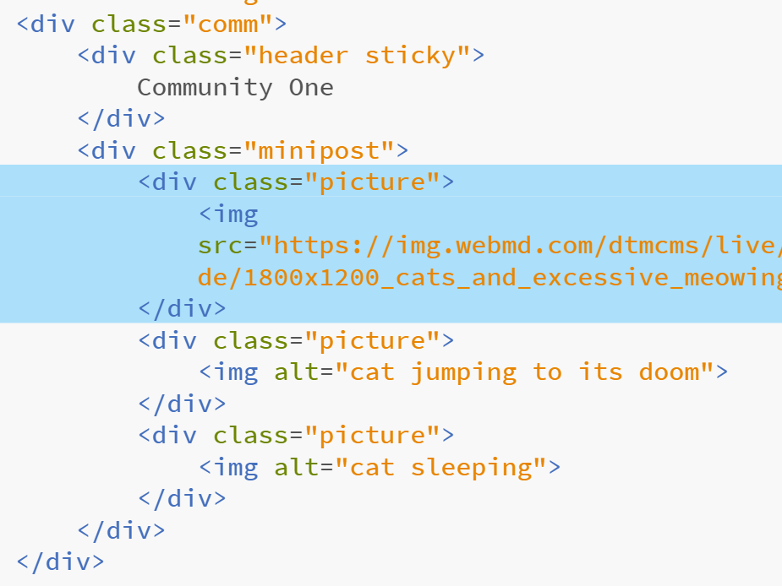

Slide 14
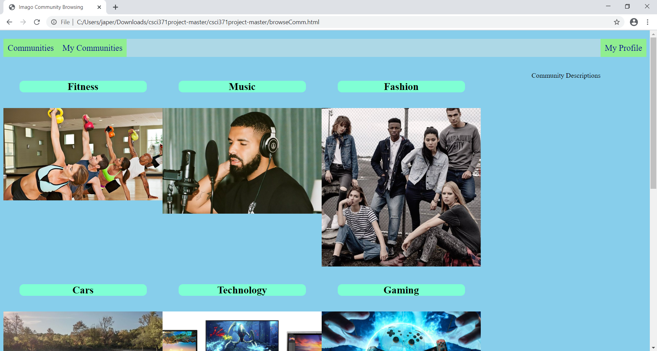

Slide 15
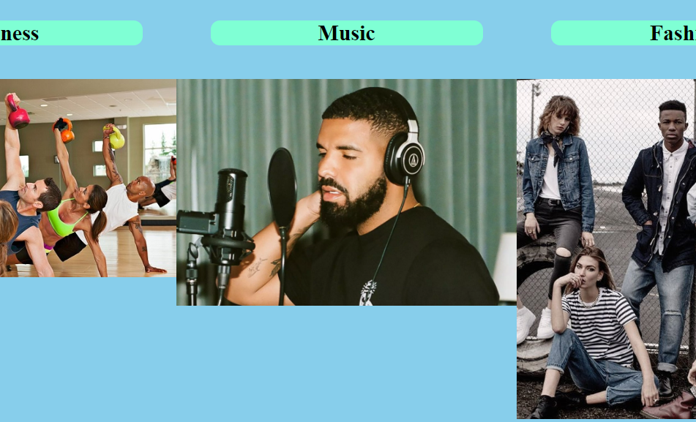
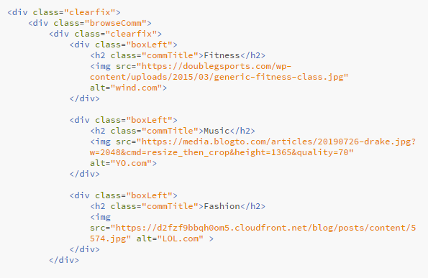
Features

Slide 17
Features

Slide 18
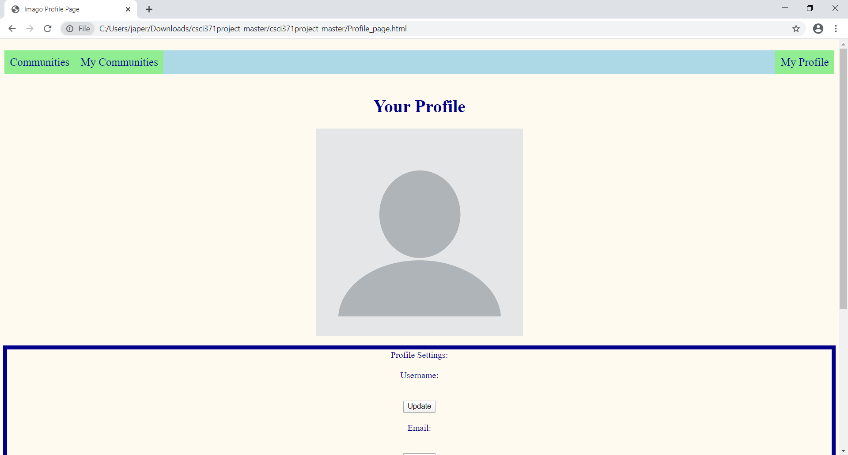

Slide 19
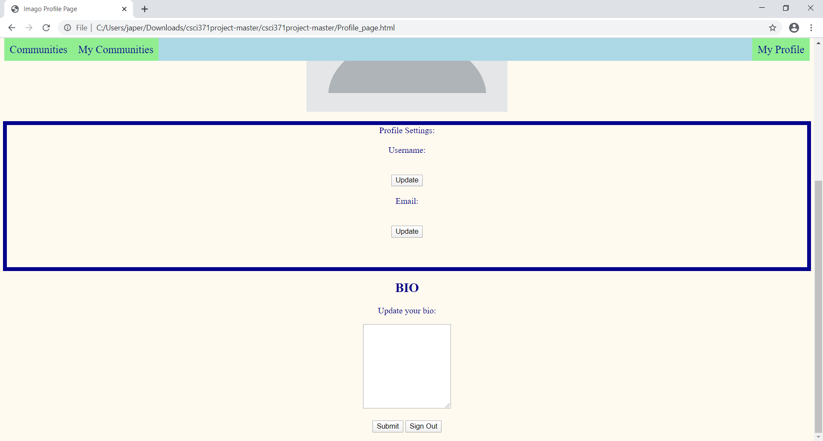

Slide 20
Imago

